Slide 1
Lecture 4 Sept. 6th ,2019
Great job in lab---100% effort and success.
Review the handout on lab reports. I have posted a sample lab report on the website.
Lab report 1 due next Thursday, Sept 12th at the beginning of your lab.

Slide 2
Where were we?
Genetic analysis techniques

Slide 3
Genetic techniques
Cutting/measuring DNA
Mapping genes
Reading DNA (sequencing)
Measuring gene expression—mRNA/protein
Altering DNA (random or directed mutagenesis)—Genetically modified cells/organisms (GMOs)
CRISPR-CAS9---unprecedented power for specifically altering DNA sequence
Be sure to read the short paper on genetic modification for human health

Slide 4
Why sequence?...what can you do with DNA sequence?
It is predicted that in your lifetime people will begin to have their entire genome sequenced at birth in order to predict diseases they are likely to get or to predict how they may respond to stresses or environmental conditions or to medications.
Even 5 years ago this was a ridiculous prediction based on cost of sequencing.

Slide 5
The human genome project took ~12 years(1991-2003) and about 2.7 billion dollars to complete. (to determine the letter sequences of one human’s DNA~ 3 billion letters.)
New technologies for sequencing have greatly reduced the time and cost of obtaining the entire letter code of all of our DNA.

Slide 6
Sequencing is getting cheaper

Slide 7
23 and me—a company for personal sequencing
Check it out!
https://www.23andme.com
There are several companies doing genetic/genomic analysis for the general public, “for fun”… For ancestry, primarily.
Why is DNA sequencing controversial?

Slide 8
Chapter 2 Mitosis and Meiosis
Mechanisms for maintaining genetic continuity between cells and sexually reproducing organisms.
Mitosis---division of a somatic cell to produce 2 cells, each with the same number of chromosomes as the parent cell.
Meiosis---cell division with the purpose of reducing the number of chromosomes by half. Produces sex cells (gametes or spores) which fuse in sexual reproduction to restore the specific number of chromosomes for that species.

Slide 9
Mitosis and Meiosis---both involve controlled distribution of cellular DNA as organized structures called chromosomes
Different species have different numbers of chromosomes, but each cell of a given species will have the same number of chromosomes (2N/diploid). During Mitosis, the diploid number is maintained in each new cell produced .
During meiosis (which occurs only in germ cells---destined to become gametes) cells are created which have the haploid number of chromosomes.

Slide 10
Chromosomes
In diploid (2n) organisms, chromosomes exist in pairs called homologs/homologous chromosomes.
Mother’s chromosomes (passed in egg) =maternal homolog
Father’s chromosomes (passed in sperm)= paternal homolog.
Diploid organisms are the result of sexual reproduction—the union of haploid gametes.

Slide 11
Chromosome structure/characteristics
Visible via microscope only in most condense/thickened state (during meiosis and mitosis) (See handout).
Have a visible constriction called centromere
In some species, chromosomes vary in size and position of the centromere.
In some organisms, each individual chromosome is recognizable—can organize and analyze with a karyotype.

Slide 12
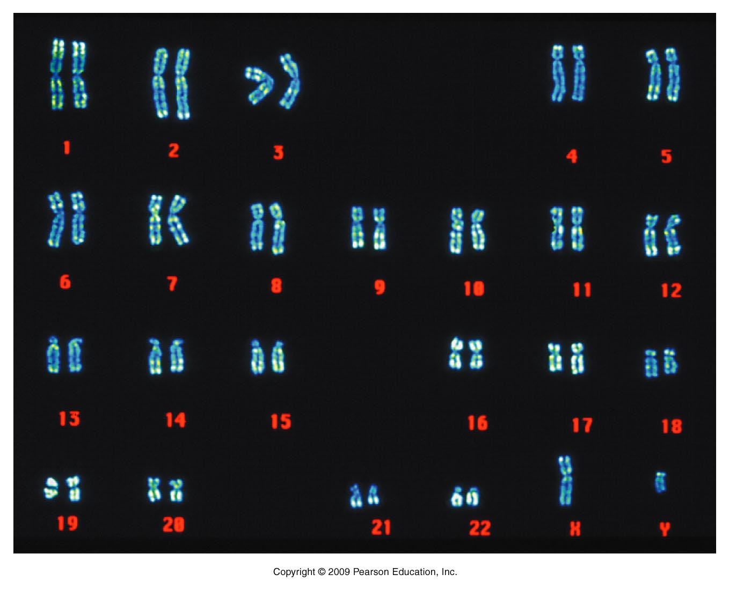
Figure 1.3
Notes:
Figure 1-3 A colorized image of the human male chromosome set. Arranged in this way, the set is called a karyotype.

Slide 13
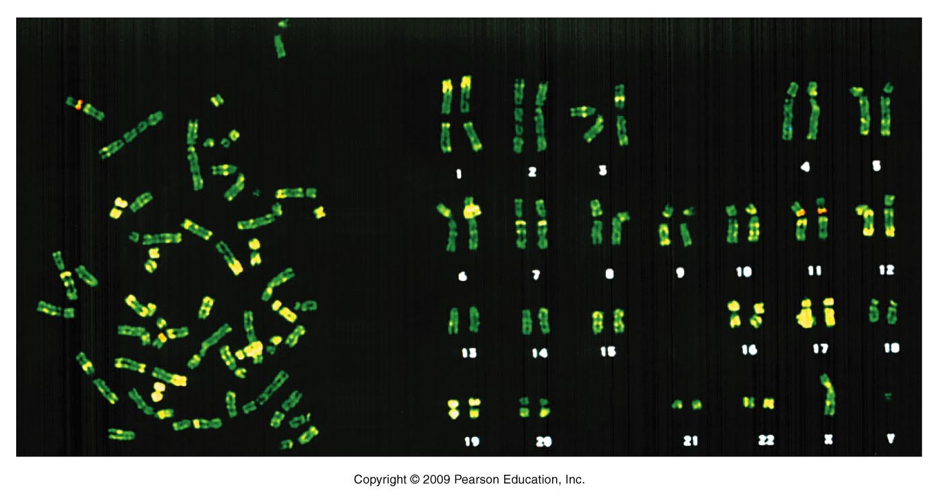
Gene “a”
Any homologous pair of chromosomes would be expected to look identical under the microscope and share the same set of genes at the same locations along the length of the chromosome.
Gene ”b”
maternal
paternal
Figure 2.4
Notes:
Figure 2-4 A metaphase preparation of chromosomes derived from a dividing cell of a human male (left), and the karyotype derived from the metaphase preparation (right). All but the X and Y chromosomes are present in homologous pairs. Each chromosome is clearly a double structure, constituting a pair of sister chromatids joined by a common centromere.

Slide 14
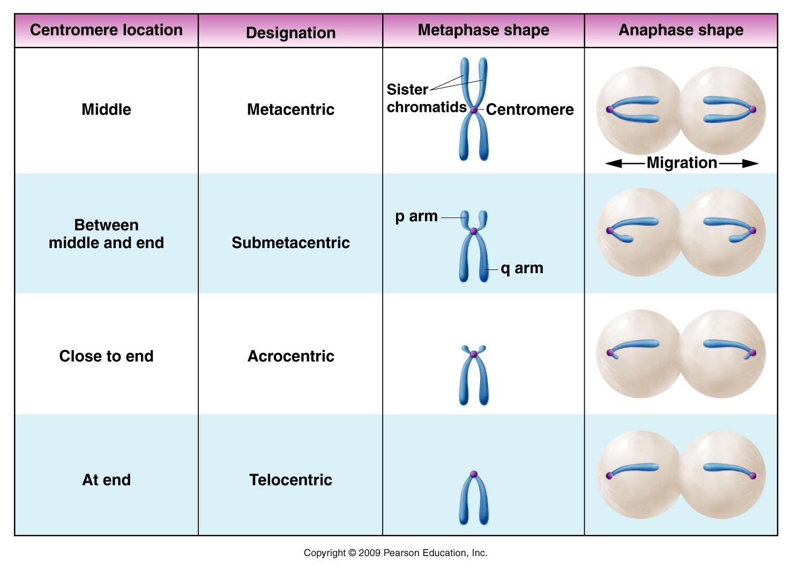
Figure 2.3
Notes:
Figure 2-3 Centromere locations and designations of chromosomes based on centromere location. Note that the shape of the chromosome during anaphase is determined by the position of the centromere.

Slide 15
Cell Cycle
Mitosis is one phase of the cell cycle in which the cells divide in two. However the most important aspect of mitosis is the partitioning of the chromosomes to 2 new cells. Strictly speaking mitosis refers to the division of the nucleus to form 2 new complete nuclei.
The rest of the cell cycle (called interphase) prepares the cell for actual division into 2 new daughter cells.

Slide 16
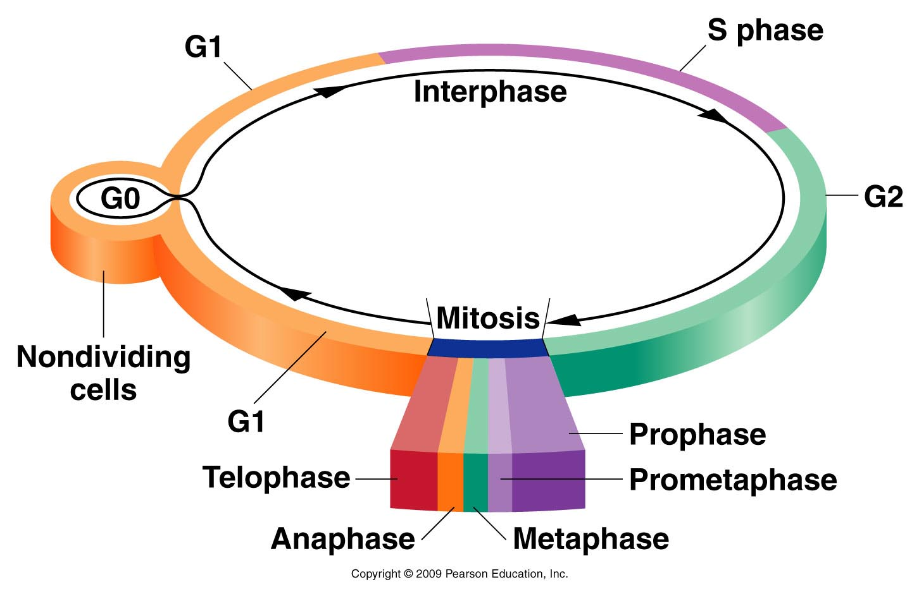
Figure 2.5
Notes:
Figure 2-5 The intervals comprising an arbitrary cell cycle. Following mitosis, cells enter the G1 stage of interphase, initiating a new cycle. Cells may become nondividing (G0) or continue through G1, where they become committed to begin DNA synthesis (S) and complete the cycle (G2 and mitosis). Following mitosis, two daughter cells are produced and the cycle begins anew for both cells.

Slide 17
Mitotic phases ensure proper partitioning of each chromosome to new daughter cells (review handout—will also use in lab)
Prophase
Prometaphase
Metaphase
Anaphase
Telophase
The phases are continuous, but we have recognized distinct changes in chromosomes—that occur in specific order.

Slide 18
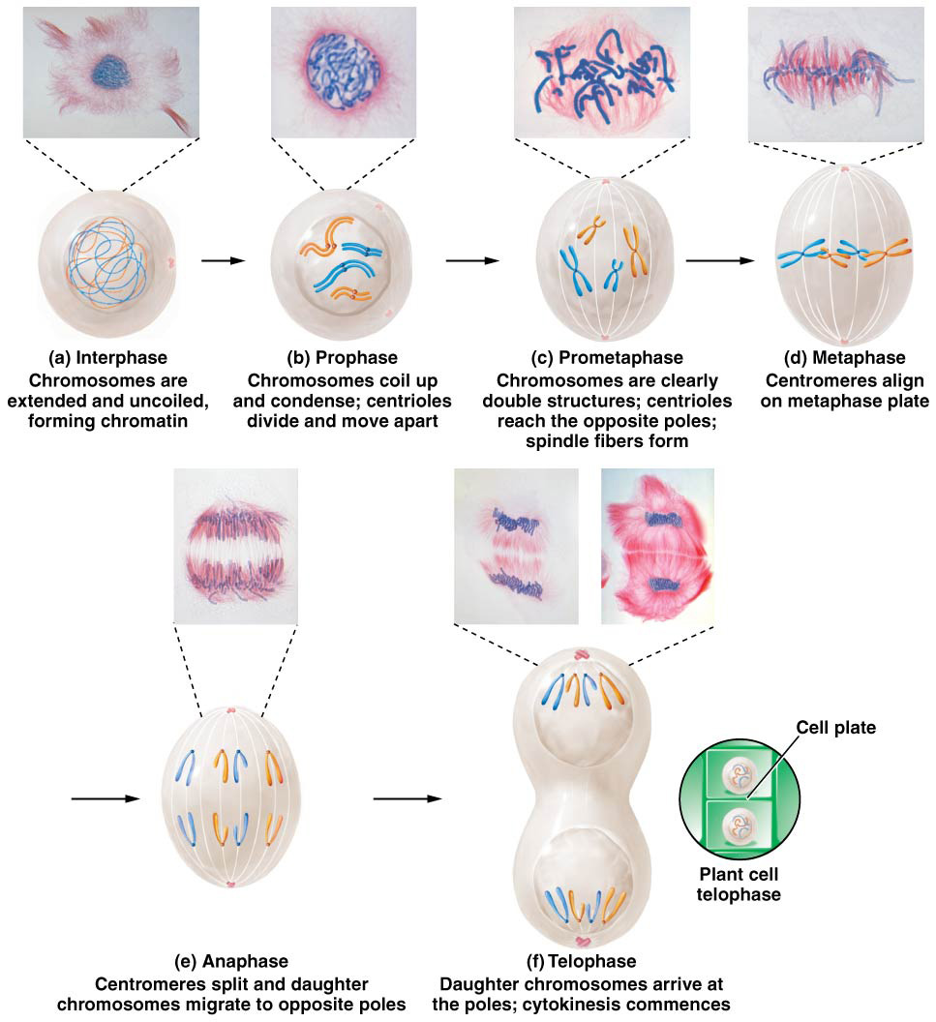
diploid number of 4.

Slide 19
Actual arrangement
Prophase
Metaphase
Anaphase
Telophase

Slide 20
Review animation!
http://www.sumanasinc.com/webcontent/animations/content/mitosis.html

Slide 21
Practice with a mosquito cell!
Track the 3 pairs of chromosomes from interphase to the 4 phases of mitosis.
Show in cartoon fashion what occurs as a mosquito cell goes through mitosis (include the whole cell cycle).

Slide 22
Cell cycle must be carefully regulated
In multicellular organisms, cells divide at different rates depending on their lifespan and purpose. (Cell division is most rapid during embryonic development. After that, cells of different tissues divide at different rates)
Cancer is the result of dis-regulated cell division. (Chapter 19*—Please read and study Sections 19.3 through 19.6)

Slide 23
The cell cycle can pause if necessary at specific points if the cell is not ready to advance to produce two perfect daughter cells
Cell cycle checkpoints
G1/S border—cell monitors its size and DNA quality
G2/M border---cell monitors completeness of DNA synthesis and checks for DNA damage
Within mitosis—Cell monitors spindle formation proper attachment of spindle to chromosomes

Slide 24
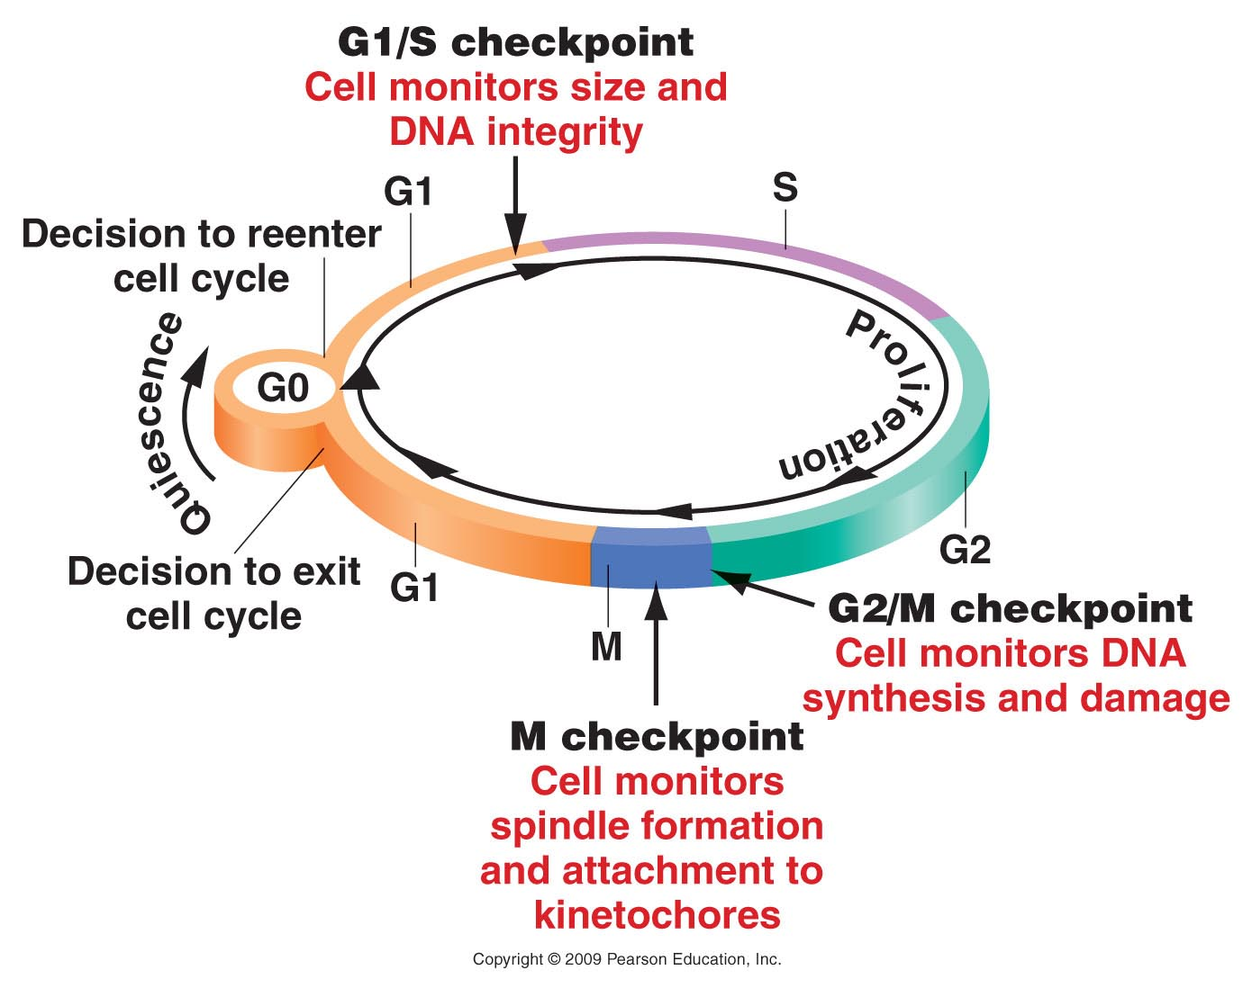
Figure 20.5
Notes:
Figure 20-5 Checkpoints and proliferation decision points monitor the progress of the cell through the cell cycle.

Slide 25
Normally a cell will pause (at one of the checkpoints) if it has incurred DNA damage or lacks the resources it needs to carry out perfect cell division.

Slide 26
If these checkpoints fail, a cell will start to accumulate DNA damage(mutations in genes), which in turn may lead to more defects in the checkpoints (which control cell division rate)….so the cell divides more…which causes it to replicate its DNA more, which leads to more mutations, some of which are in checkpoint genes....so the cell divides more....

Slide 27
Cells that have accumulated many mutations, such that regulation of cell division/mitosis is lost--- become piles of cells--tumors----CANCER.

Slide 28
Let’s clarify--
Cancer is an abnormal accumulation of cells.
Each cancer is essentially clonal---originating from one cell.
The original cell has lost some aspect of cell division control, which can lead to further loss of control— and the result is lots of cells.

Slide 29
Some of the DNA damage/mutations are easy to spot.
Extra chromosomes
Missing chromosomes
Broken or fused chromosomes
Since genes reside on/in chromosomes, extra chromosomes mean extra copies of genes, missing chromosomes mean missing genes…broken and fused chromosomes mean parts of genes may be missing or fused together.

Slide 30
Karyotype from tumor cells from brain cancer---YIKES!

Slide 31
If working normally, a cell cycle pause may allow the cell to repair DNA damage, accumulate resources, or grow so that it can divide and produce 2 healthy cells.

Slide 32
Figure 20.5
Notes:
Figure 20-5 Checkpoints and proliferation decision points monitor the progress of the cell through the cell cycle.

Slide 33
Specific proteins work together to move the cell past cell cycle checkpoints.
Cyclins (which accumulate and disappear over time—in cycles)
Cyclin-dependent kinases (proteins which bind to cyclins and are enzymes which add phosphate groups to other proteins.

Slide 34
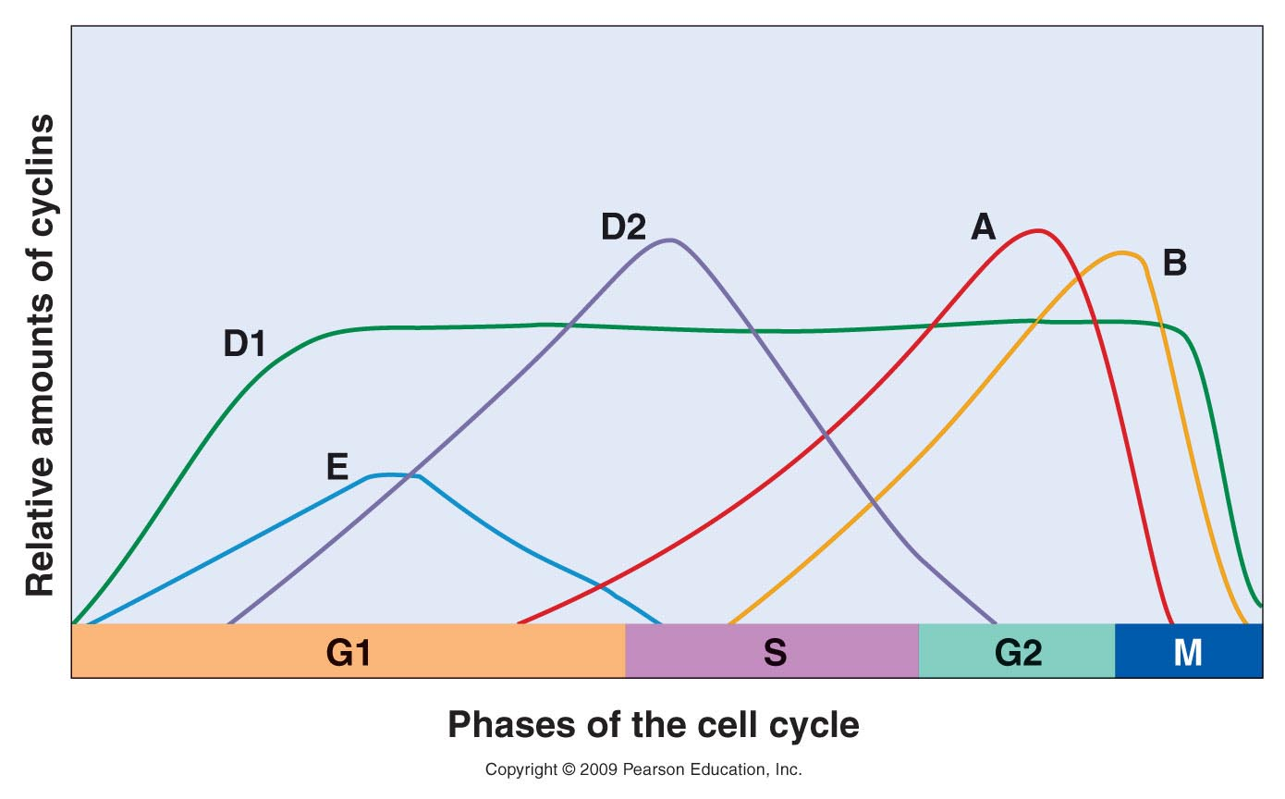
Figure 20.6
Notes:
Figure 20-6 Relative expression times and amounts of cyclins during the cell cycle. Cyclin D1 accumulates early in G1 and is expressed at a constant level through most of the cycle. Cyclin E accumulates in G1, reaches a peak, and declines by mid S phase. Cyclin D2 begins accumulating in the last half of G1, reaches a peak just after the beginning of S, and then declines by early G2. Cyclin A appears in late G1, accumulates through S phase, peaks at the G2/M transition, and is rapidly degraded. Cyclin B peaks at the G2/M transition and declines rapidly in M phase.

Slide 35
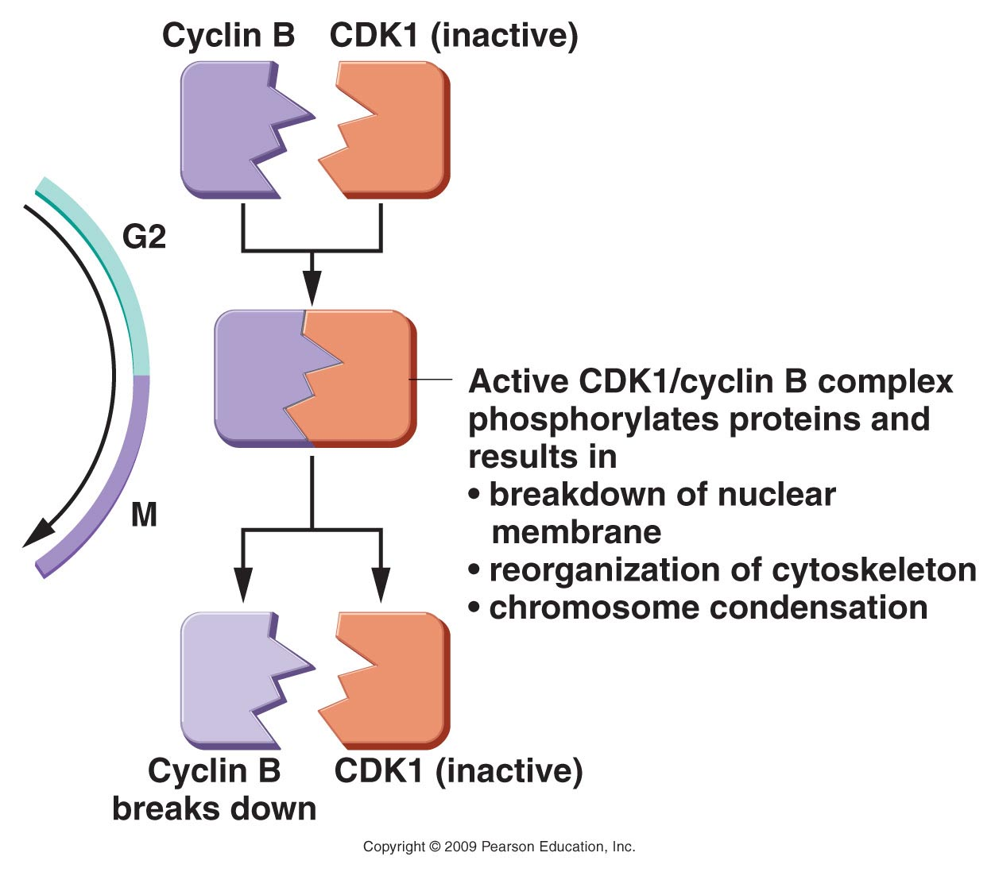
Figure 20.7
Notes:
Figure 20-7 Transition from G2 to M phase is controlled by CDK1 and cyclin B. These molecules interact to form a complex that adds phosphate groups to cellular components. These in turn bring about the structural and biochemical changes necessary for mitosis (M phase).

